Slide 1
PROBLEM DEFINITION AS A STATE-SPACE SEARCH

Slide 2
Problem
Something that has to be solved
Problems are the issues which comes across any system
A solution is needed to solve that particular problem

Slide 3
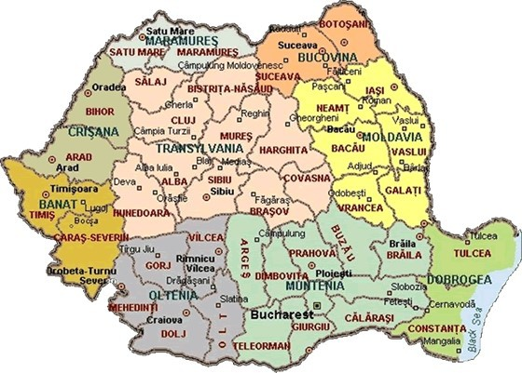
Example: Romania Touring

Slide 4
Example: Romania Touring
On holiday in Romania; currently in Arad
Non-refundable ticket to fly out of Bucharest tomorrow morning.
Formulate goal (perf. evaluation):
be in Bucharest before the flight
Formulate problem:
states: various cities
actions: drive between cities
Search:
sequence of cities

Slide 6
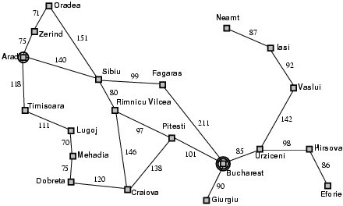
Road Map of Romania

Slide 7
Well-Defined Problems
A problem can be defined formally by five components:
Initial state
Actions
Transition model: description of what each action does (successor)
Goal test
Path cost
7

Slide 8
Road Map of Romania

Slide 9
Problem Formulation – 5 Components
Initial state: In(Arad)
Actions, if current state is In(Arad), actions = {Go(Sibiu), Go(Timisoara), Go(Zerind)}
Transition model:
e.g., Results (In(Arad), Go(Sibiu)) = In(Sibiu))
Goal test determines whether a given state is a goal state
explicit, e.g. In(Bucharest)
implicit, e.g. checkmate
Path cost function that assigns a numeric cost to each path
e.g., distance traveled
step cost: c(x, a, y)
Solution: a path from the initial state to a goal state
Optimal solution: the path that has the lowest path cost among all solutions; measured by the path cost function

Slide 10
Problem Abstraction
Real world is complex and has more details
Irrelevant details should be removed from state space and actions, which is called abstraction
What’s the appropriate level of abstraction?
the abstraction is valid, if we can expand it into a solution in the more detailed world
the abstraction is useful, if carrying out the actions in the solution is easier than the original problem
remove as much detail as possible while retaining validity and usefulness

Slide 11
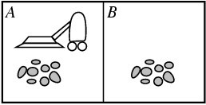
Example: Vacuum-Cleaner
States
8 states
Initial state
any state
Actions
Left, Right, and Suck
Transition model
complete state space, see next page
Goal test
whether both squares are clean
Path cost
each step costs 1

Slide 12
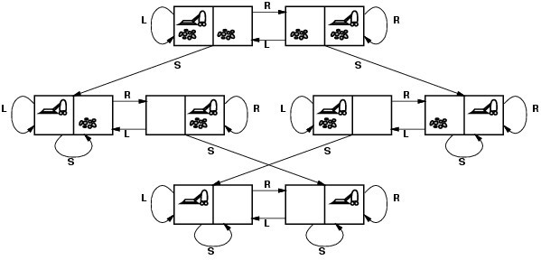
Complete State Space

Slide 13
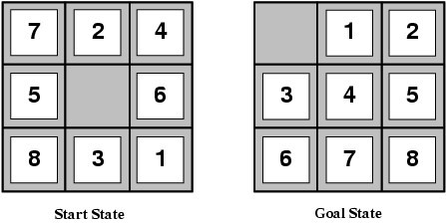
Example: 8-puzzle
NP-Complete
States:
location of each tile and the blank
Initial state: any, 9!/2
Actions:
blank moves Left, Right, Up or Down
Transition model:
Given a state and action, returns the resulting state
Goal test: Goal configuration
Path cost: Each step costs 1

Slide 14
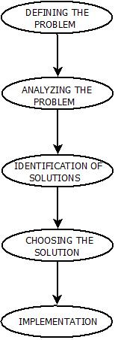
Problem Solving in Artificial Intelligence

Slide 15
Steps in Problem Solving
Defining The Problem: The definition of the problem must be included precisely. It should contain the possible initial as well as final situations which should result in acceptable solution
Analyzing The Problem: Analyzing the problem and its requirement must be done as few features can have immense impact on the resulting solution

Slide 16
(Contd..)
Identification of Solutions: This phase generates reasonable amount of solutions to the given problem in a particular range.
Choosing a Solution: From all the identified solutions, the best solution is chosen basis on the results produced by respective solutions
Implementation: After choosing the best solution, its implementation is done

Slide 17
Problem space
An abstract space
Encompasses all valid states that can be generated by the application of any combination of operators on any combination of objects
The problem space may contain one or more solutions
A solution is a combination of operations and objects that achieve the goals

Slide 18
Problem definitions
To provide a formal description of a problem, it is needed to :
Define a state space that contains all the possible configurations of the relevant objects, including some impossible ones.
Specify one or more states that describe possible situations, from which the problem solving process may start – called initial states
Specify one or more states that would be acceptable solution to the problem- called goal states

Slide 19
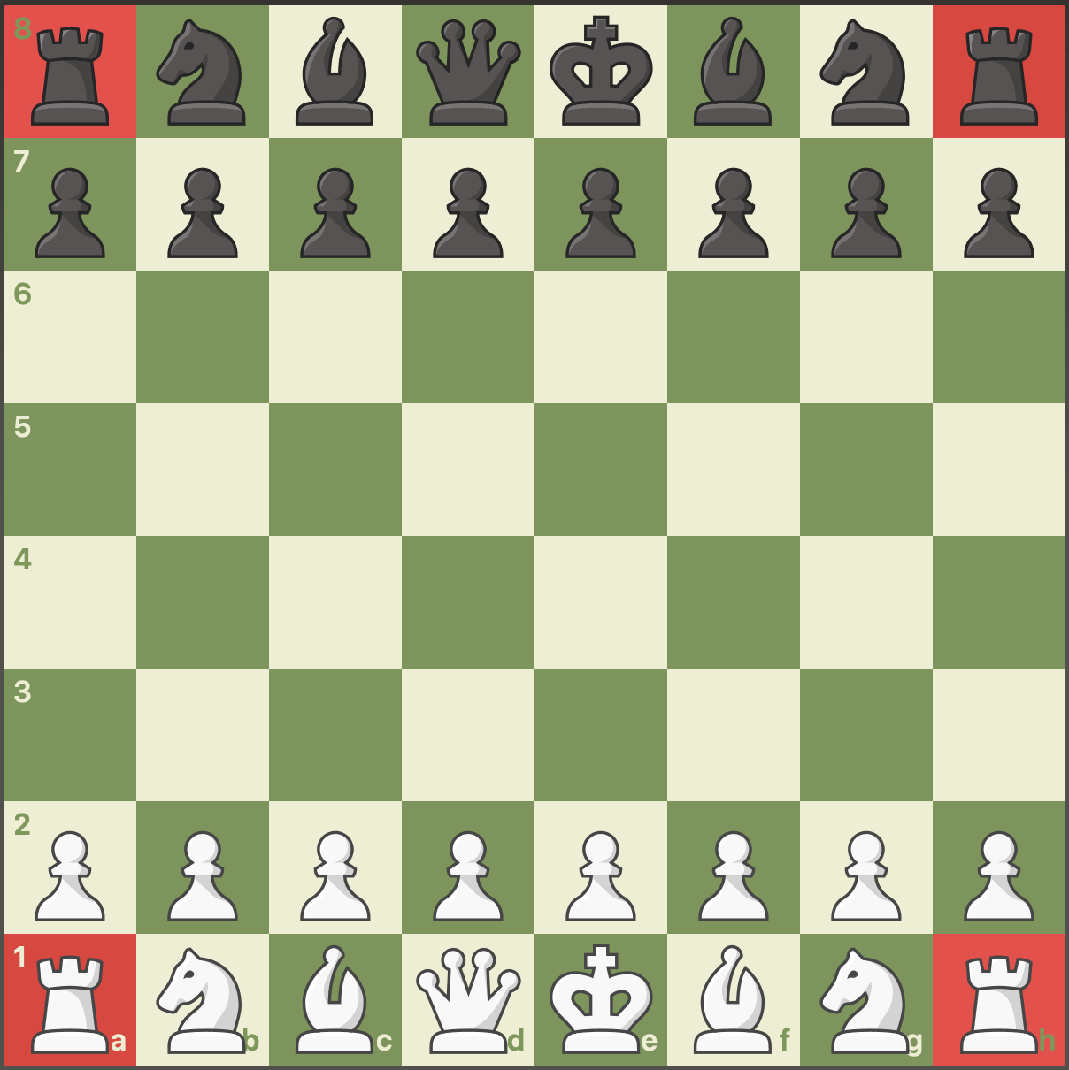
Initial state

Slide 20
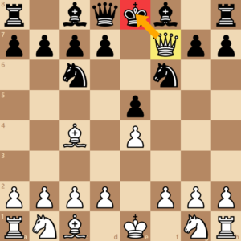
Goal state

Slide 21
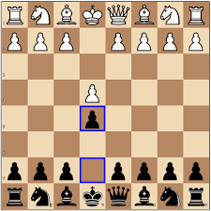
State space

Slide 22
Search
The problem can then be solved by using rules, in combination with an appropriate control strategy, to move through the problem space until a path from an initial state to a goal state is found
This process is known as search

Slide 23
Search
Fundamental to the problem-solving process.
A general mechanism that can be used when a more direct method is not known.
Provides the framework into which more direct methods for solving subparts of a problem can be embedded
A very large number of AI problems are formulated as search problems

Slide 24
Search Tree
A problem space is represented by a directed graph, where nodes represent search state and paths represent the operators applied to change the state.
To simplify search algorithms, it is often convenient to logically and programmatically represent a problem space as a tree.
A tree usually decreases the complexity of a search at a cost.

Slide 25
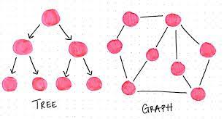
A tree is a graph in which any two vertices are connected by exactly one path.
Alternatively, any connected graph with no cycles is a tree.

Slide 26
Searching for Solutions
Search tree: generated by initial state and possible actions
Basic idea:
simulated exploration of state space by generating successors of already-explored states (expanding states)
the choice of which state to expand is determined by search strategy

Slide 27
Road Map of Romania

Slide 28
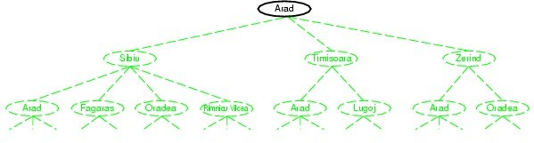
Tree Search Example

Slide 29
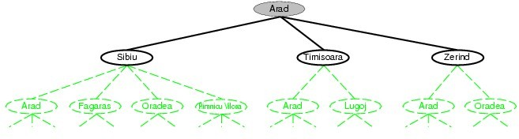
Tree Search Example

Slide 30
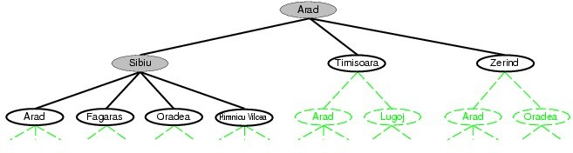
Tree Search Example

Slide 31
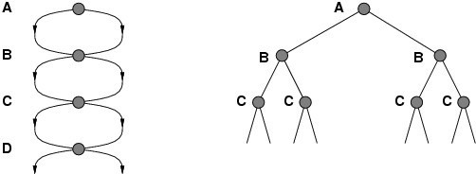
Avoiding Repeated States
Failure to detect repeated states can turn a linear problem into an exponential one!
Algorithms that forget their history are doomed to repeat it
state space size: d + 1 → search tree leaves: 2^{d}

Slide 32
State Space
A state is a representation of problem elements at a given moment.
A State space is the set of all states reachable from the initial state.
A state space forms a graph in which the nodes are states and the arcs between nodes are actions.

Slide 33
(Contd..)
In the state space, a path is a sequence of states connected by a sequence of actions
The solution of a problem is part of the graph formed by the state space
The state space representation forms the basis of most of the AI methods

Slide 34
Search Algorithm Terminologies
Search: A step by step procedure to solve a search-problem in a given search space
A search problem can have three main factors:
Search Space: Search space represents a set of possible solutions, which a system may have.
Start State: State from where agent begins the search
Goal test: Function which observe the current state and returns whether the goal state is achieved or not

Slide 35
(Contd..)
Search tree: A tree representation of search problem is called Search tree. The root of the search tree is the root node which is corresponding to the initial state
Actions: It gives the description of all the available actions to the agent
Transition model: A description of what each action do, can be represented as a transition model

Slide 36
(Contd..)
Path Cost: It is a function which assigns a numeric cost to each path
Solution: It is an action sequence which leads from the start node to the goal node
Optimal Solution: If a solution has the lowest cost among all solutions

Slide 37
Properties of Search Algorithms
To compare the efficiency of these algorithms:
Completeness: A search algorithm is said to be complete if it guarantees to return a solution if at least any solution exists for any random input
Optimality: If a solution found for an algorithm is guaranteed to be the best solution (lowest path cost) among all other solutions, then such a solution for is said to be an optimal solution

Slide 38
(Contd..)
Time Complexity: A measure of time for an algorithm to complete its task
Space Complexity: Maximum storage space required at any point during the search, as the complexity of the problem

Slide 39
Defining Problem as a State Space Search
To solve the problem of playing a game, we require the rules of the game and targets for winning as well as representing positions in the game
The opening position can be defined as the initial state and a winning position as a goal state. Moves from initial state to other states leading to the goal state follow legally
However, the rules are far too abundant in most games— especially in chess
Thus, the rules cannot be supplied accurately and computer programs cannot handle easily
The storage also presents another problem but searching can be achieved by hashing

Slide 40
(Contd..)
The number of rules that are used must be minimized and the set can be created by expressing each rule in a form as possible
The representation of games leads to a state space representation and it is common for well-organized games with some structure
This representation allows for the formal definition of a problem that needs the movement from a set of initial positions to one of a set of target positions
It means that the solution involves using known techniques and a systematic search. This is quite a common method in Artificial Intelligence.

Slide 41
THANK YOU

